Slide 1
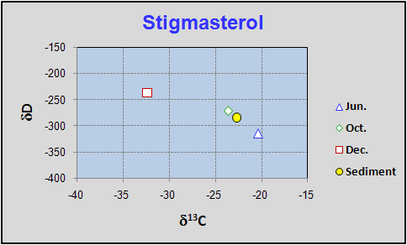
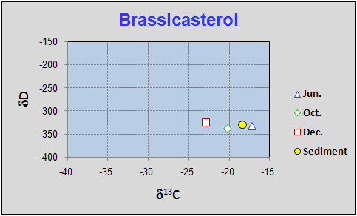
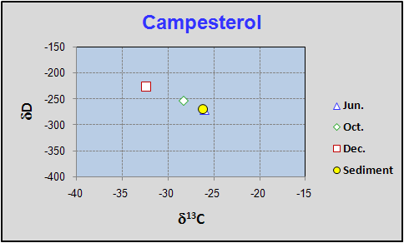
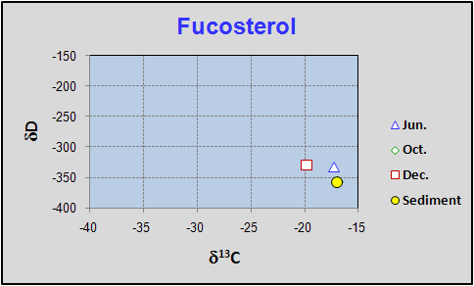
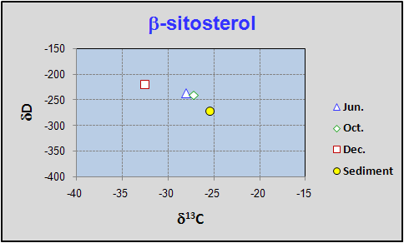
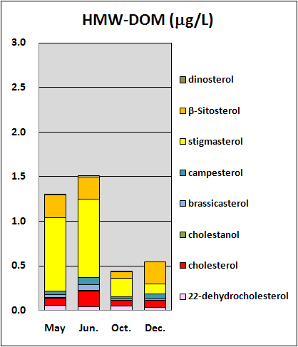
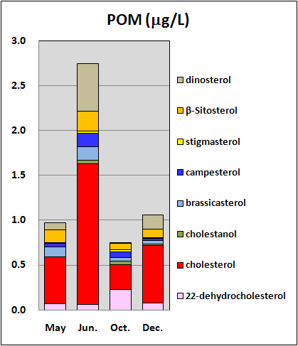
IMOG 2011
Interlaken
NATURE OF C₂₉ STEROLS ASSOCIATED WITH HIGH-MOLECULAR WEIGHT DISSOLVED ORGANIC MATTER (HMW-DOM) FROM A FRESHWATER LAKE.
Kazuo Fukushimaª *, Koji Takahashiª, Yasuko Yoshiyamaª, Yoshito Chikaraishi^{b}
ª Shinshu University, Faculty of Sciences, ^{b} JAMSTEC-IFREE
(* corresponding author: kfukush@shinshu-u.ac.jp)
P-237
ABSTRACT
Our previous work revealed that sterols associated with HMW-DOM (High Molecular-Weight Dissolved Organic Matter), which were separated from freshwater lakes by using a tangential ultrafiltration technique, are predominated by C₂₉ sterol (24-ethylcholest-5,22-dien-3β-ol: stigmasterol). The abundance of stigmasterol, however, varied considerably throughout the year. In the present work, we aimed to unravel the nature and sources of the sterol, by analyzing carbon and hydrogen stable isotope ratios. The stable carbon isotope ratio, δ¹³C, of stigmasterol varied from -20.4 ‰ in summer (June) to -32.4‰ in winter (December), while δD varied from -315 to -237 ‰, both of which were by far larger than those of other sterols, Two-dimensional plots on δ¹³C and δD suggested that most stigmasterol associated with HMW-DOM should originate from aquatic organisms in summer and the contribution should decrease as the primary production within the lake water decreases towards winter.
RESULTS AND DISCUSSION
Table 1 shows bulk nature of HMW-DOM as revealed by C/N ratio, δ¹³C and δ¹⁵N. They vary little throughout the year as had been noticed by Yoshiyama et al. (2003). The three data sets are situated in the intermediate region between eutrophic and oligotrophic lakes, indicating a contribution of aquatic organisms to the formation of HMW-DOM. Fatty acids dominated by C₁₄-C₁₈ short-chain unsaturated and saturated species support a participation of algal and/or microbial lipids.
On the contrary, composition of sterols associated with HMW-DOM is quite characteristic, where C₂₉ stigmasterol is by far dominant particularly in summer seasons (Fig.1). The predominance of stigmasterol in HMW-DOM is more or less common among every HMW-DOM sample hitherto examined (Yoshiyama et al., 2003), irrespective of trophic status or salinity of the lake water. It is contrast to the sterol composition of POM (Particulate Organic Matter). Stigmasterol in POM is only minor and major sterol is cholesterol. Another point to be remarked is a considerable decline in its absolute abundance and relative proportion towards winter.
Seasonal variations of δ¹³C and δD of the sterols are shown in Fig.2. These data are depicted on δ¹³C-δD cross plot in Fig.2. Thee types of distribution are discerned: 1) campesterol and β-sitosterol, 2) brassicasterol and 3) stigmaterol. According to the study by Chikaraishi et al. (2005) on the sedimentary sterols in a riverine to marine system, marine algae end-member is tentatively ascribed to the range of -20 to -25 ‰ (δ¹³C) and -280 to 310 ‰ (δD), respectively. Thus it is presumed that stigmasterol in summer freshwater lake HMW-DOM might also originate from phytoplankton.
INTRODUCTION
Lipid compounds have a potential to be used for source characterization of organic matter in the environment. Particular attention has been paid to sterol composition (e.g., Huang and Meinschein, 1979). At that time, most C₂₉ sterols had been believed to be terrestrial higher plants origin. Later works, however, demonstrated that phytoplankton and algae also produce C₂₉ sterols (e.g., Volkman, 2003; Rampen et al., 2010). In the study of marine sediment, Matsumoto et al. (2001) showed that compound specific stable carbon isotope ratio may be utilized for discrimination of the sterol sources. Chikaraishi et al. (2004) conducted a comprehensive work on the carbon and hydrogen isotope compositions of lipid compounds isolated from terrestrial and aquatic plants.
Our previous work (Yoshiyama et al., 2002; Takahashi et al. unpublished and partly presented at IMOG 2007) showed that sterols associated with HMW-DOM (MCO>1000 Da) from fresh and brackish water lakes in Japan are dominated by stigmasterol and its concentration was high in summer and low in winter. Thus in the present work, we conducted carbon and hydrogen stable isotope analyses of individual sterols for their source identification.
Fig.2 Seasonal variation of δ¹³C and δD of individual sterols in HMW-DOM from Kizaki-ko
29Δ^{5,22}
EXPERIMENTAL
Lake water was collected in May, June, October and December 2007 from a freshwater mesotrophic Kizaki-ko located in Nagano Prefecture, Japan (Max. Depth 29m: Saijo and Hayashi, 2001). DOM in GF (0.6 mmφ) filtrate (100L) was condensed and separated by combination of Tangential Flow Ultrafiltration (TFF), classical ultrafiltration and lyophilization. Solid DOM was characterized by C/N ratio and stable isotope composition. Lipids associated with the HMW-DOM were analyzed after saponification in 1M KOH/MeOH for the neutral constituents. Sterols were determined by using an HP 5890 Series II GC and HP6890-GC-HP 5973MSD GC-MS. Stable carbon and hydrogen isotope ratios of sterols were determined by Agilent 6890N GC combined with Finigan Delta plus XP (Chikaraishi et al., 2005). Prior to injection, sterols were fractionated into 3 parts by Ag impregnated silica gel chromatography.
28Δ^{5,22}
28Δ⁵
Table 1 Elemental composition and C, N stable isotope ratios of HMW-DOM examined in this work
29Δ^{5,24(28)}
29Δ⁵
Fig. 1 Sterol concentrations and compositions in HMW-DOM and POM (Particulate Organic Matter)
Algal sterols
Terrigenous sterols
CONCLUSION
1) In the freshwater lake system, 24-ethylcholest-5,22-dien-3β−ol (stigmasterol) was a major and most variable sterol in the HMW-DOM (0.6 μm<<1000 Da).
2) Stable isotope ratios of C and H of the sterols associated with HMW-DOM indicated that stigmasterol in summer may be derived from some aquatic organisms, while fucosterol and β-sitosterol may be almost entirely from algae and terrestrial plants, respectively.
3) Production of C₂₉ sterols including stigmasterol by phytoplankton is known (Volkman, 2003). The question is how and why only stigmasterol is concentrated in HMW-DOM.
Table 2 Stalbe carbon and hydrogen isotope ratios of sterols associated with HMW-DOM
REFERENCES
Chikaraishi et al. (2004) Phytochem. 65, 1369-1381.
Chikaraishi et al. (2005) Limnol. Oceanogr. 50, 1763-1770.
Huang and Meinschein (1979) Geochim. Cosmochim. Acta, 43, 739-745.
Matsumoto et al., (1996) Org. Geochem. 32, 259-269.
Rampen et l. (2010) Limnol. Oceanogr. 55, 91-105.
Saijo and Hayashi (eds.) (2001) Lake Kizaki, Buckhuys Publisher.
Volkman et al. (1999) Org. Geochem. 30, 307-318.
Volkman (2003) Appl. Microbiol. Biotechnol. 60, 495-506.
Yoshiyama et al. (2003) Res. Org. Geochem., 18, 37-45. (in Japanese)
トピックスに戻る

